Slide 1
Surgical Simulation
Team Elephant(4)
Members:
Aaron Tse
Jeffrey Oduro
Ondra Chan
Kevin De Asis

Slide 2
Introduction (5 sec)
Team Elephant(4)
Members:
Aaron Tse
Jeffrey Oduro
Ondra Chan
Kevin De Asis

Slide 3
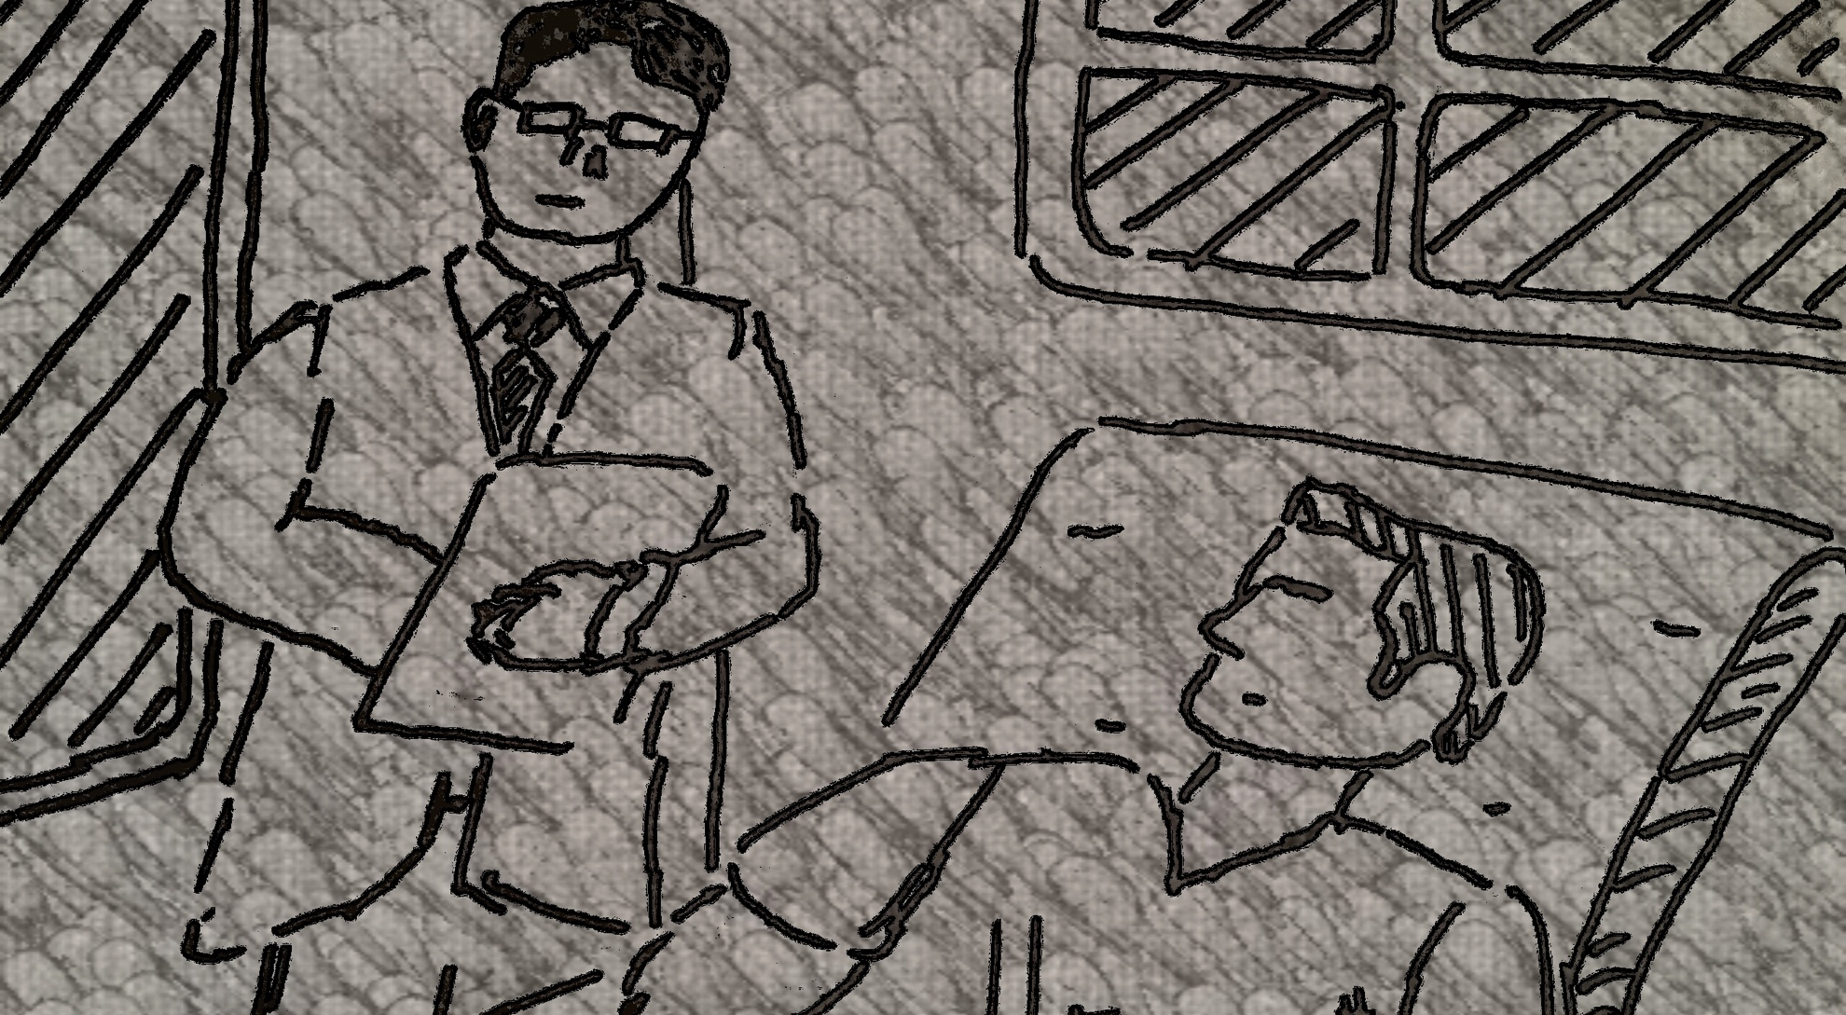
Surgeon with Patient (45 sec)

Slide 4
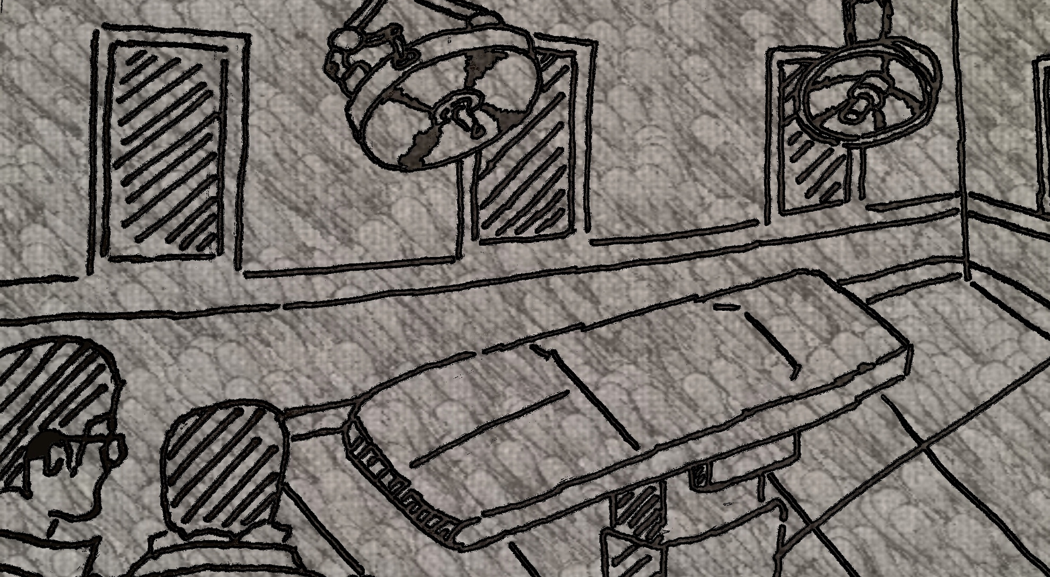
Surgery Room with Doctor and Patient (10 sec)

Slide 5
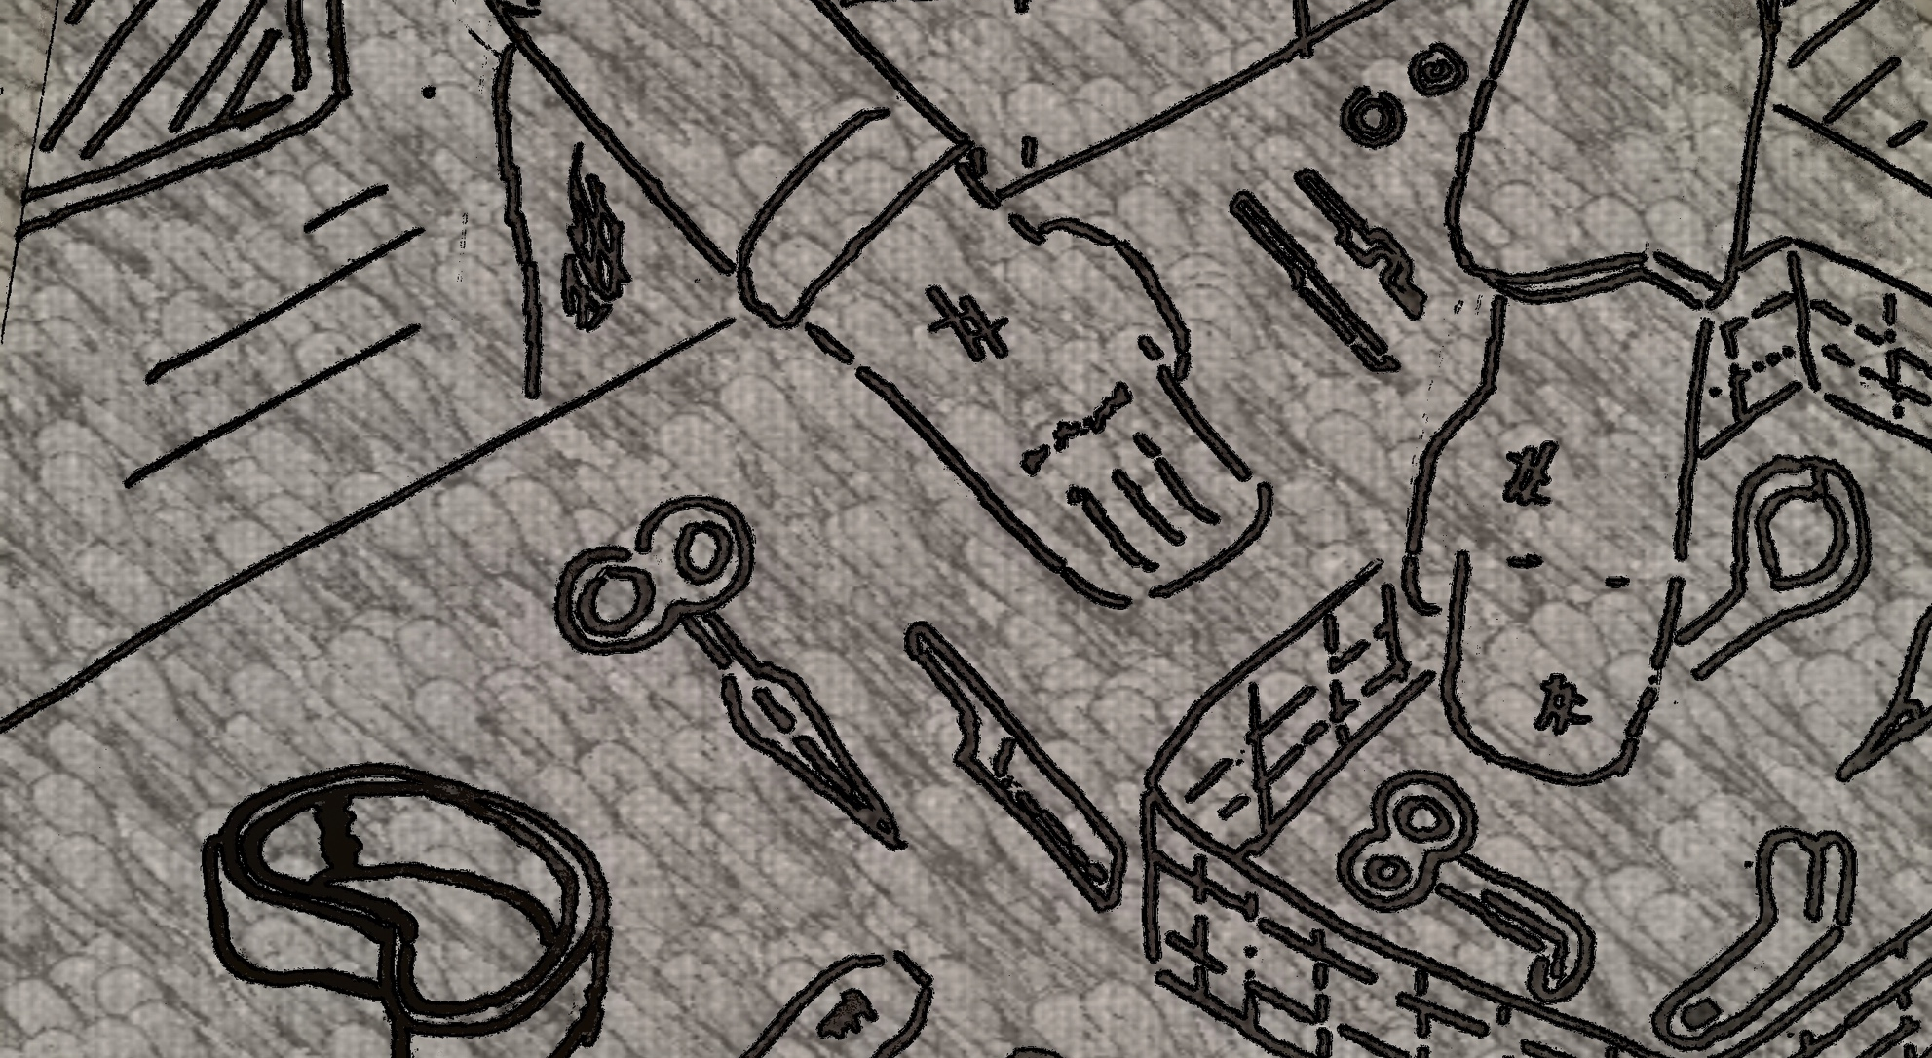
Prep Material (10 sec)

Slide 6
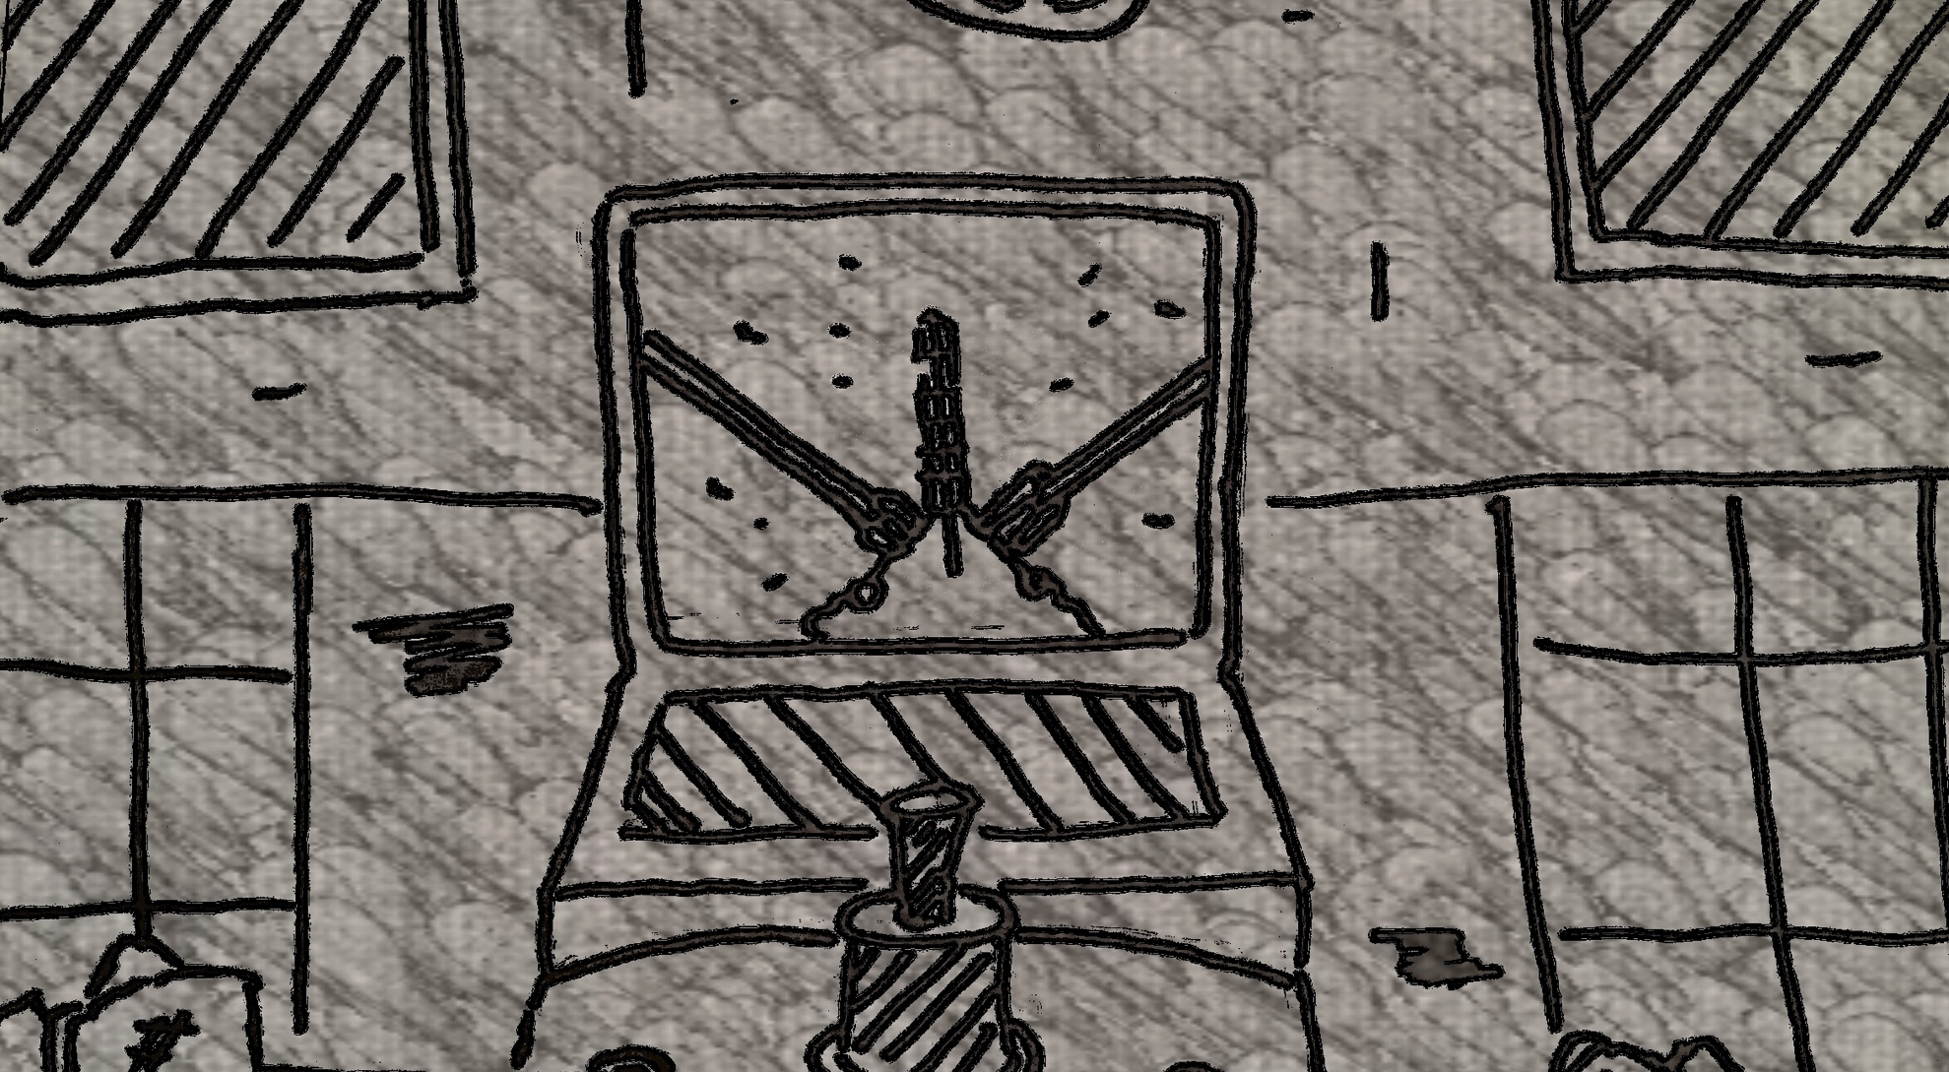
Surgery Training (15 sec)

Slide 7
Transition from training to surgery (5)

Slide 8
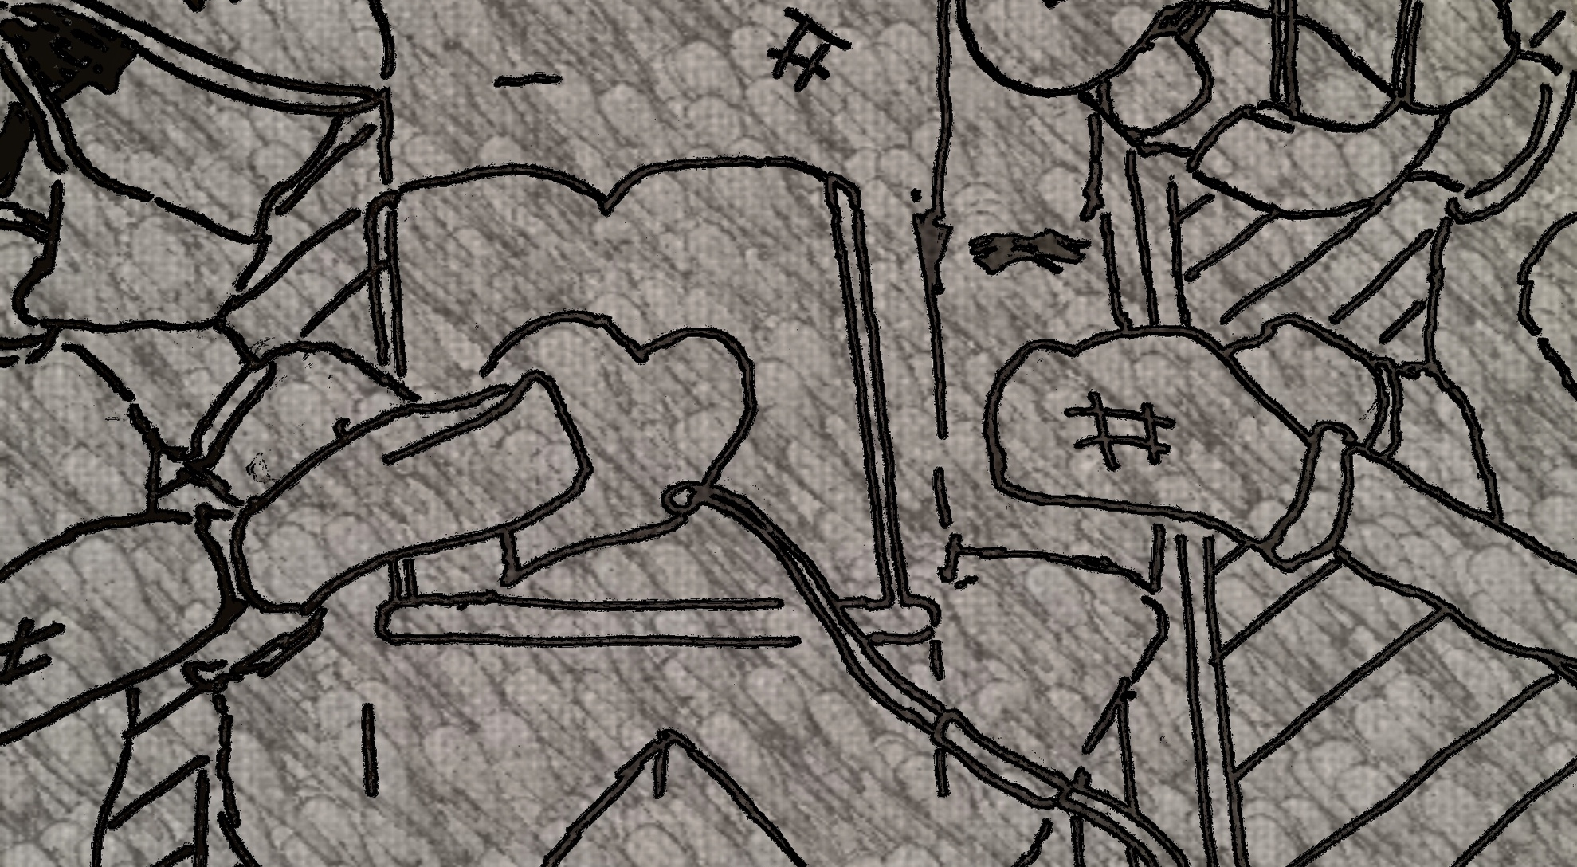
Operation (50 sec)

Slide 9
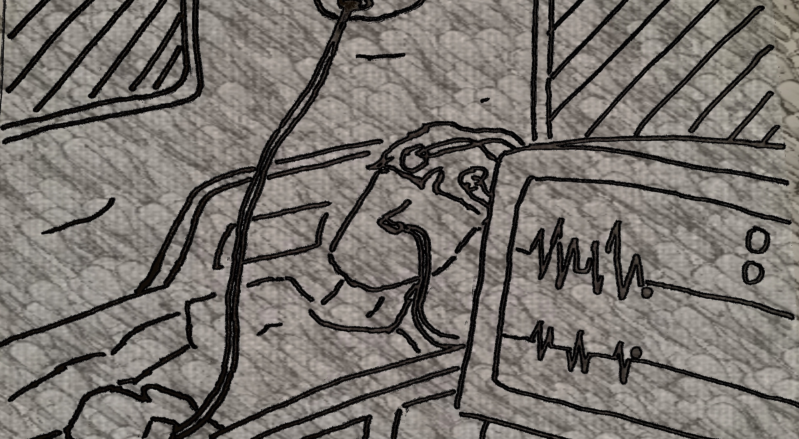
Flat-line heart rate monitor (10 sec)

Slide 10
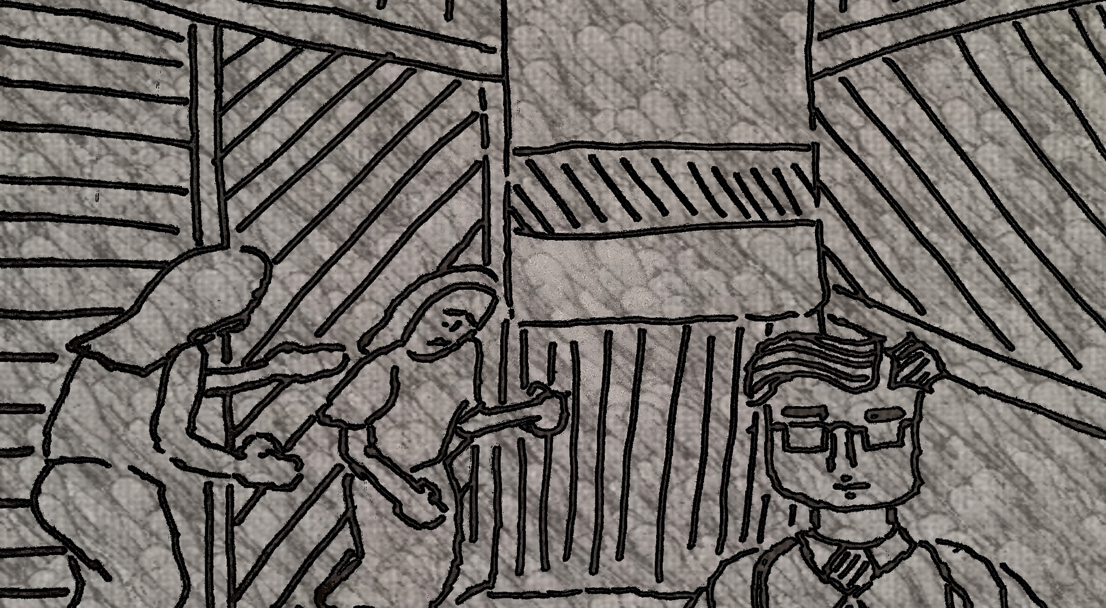
Talking to the family and walkout (15 sec)

Slide 11
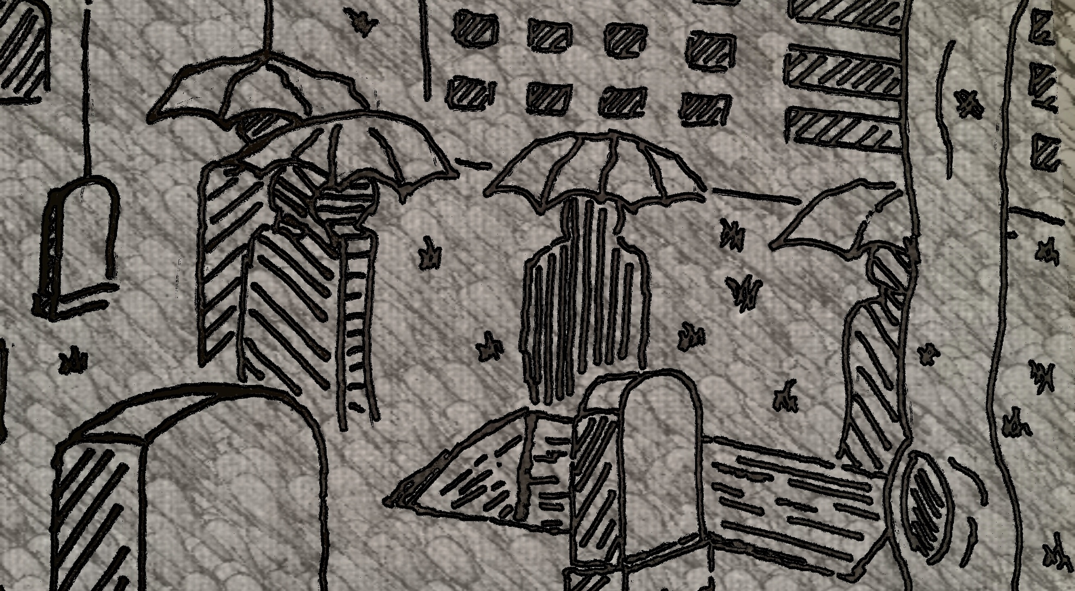
Funeral (20 sec)

Slide 12
Outro 10 sec

